Slide 1
Cravis-Mini Investigate Result
I
Overview
II
Investigate result
III
Difficult point and Solution
IV
Schedule
PIC : Visual Group
Dept : AED

Slide 2
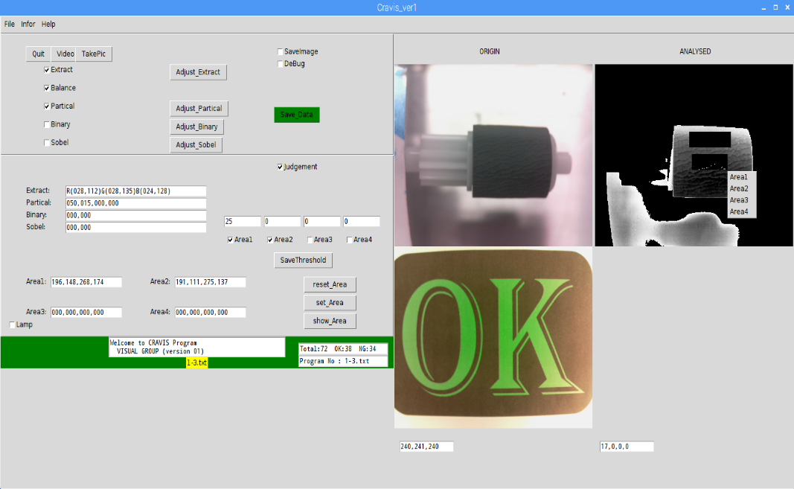
I. OVERVIEW
1.1. Hardware
650 $ / set
Cravis mini
PiCamera
Power Cable
Monitor
Mouse
Key Board
PC mini
Lighting system
Controller
1.2. Software
Compiler + Python
Geany
Spider
QT design
Connect with external devices
Auto system

Slide 3
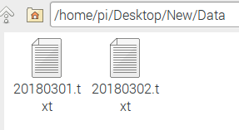

II. INTERFACE
2.1. Interface
parameter
Total Result
Result for Area
RGB value
Notes:
At the same time

Slide 4
II. INTERFACE

Slide 5
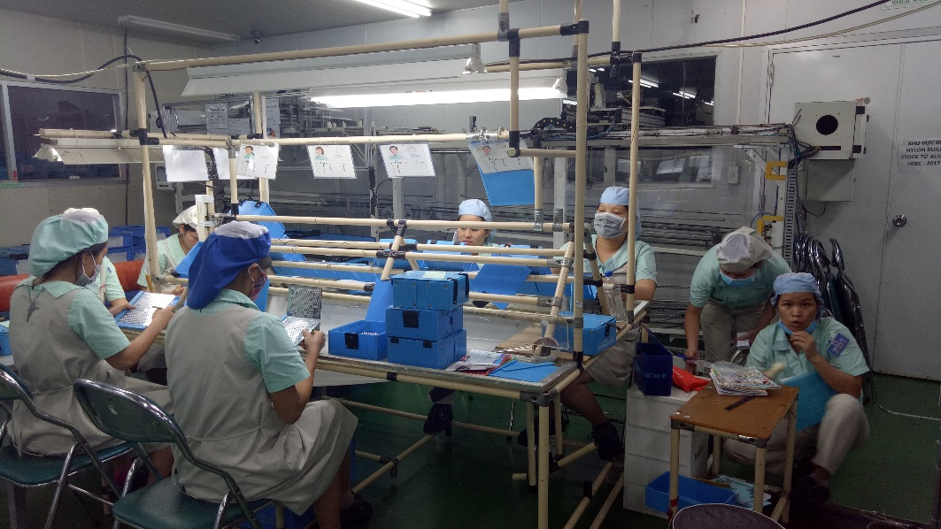
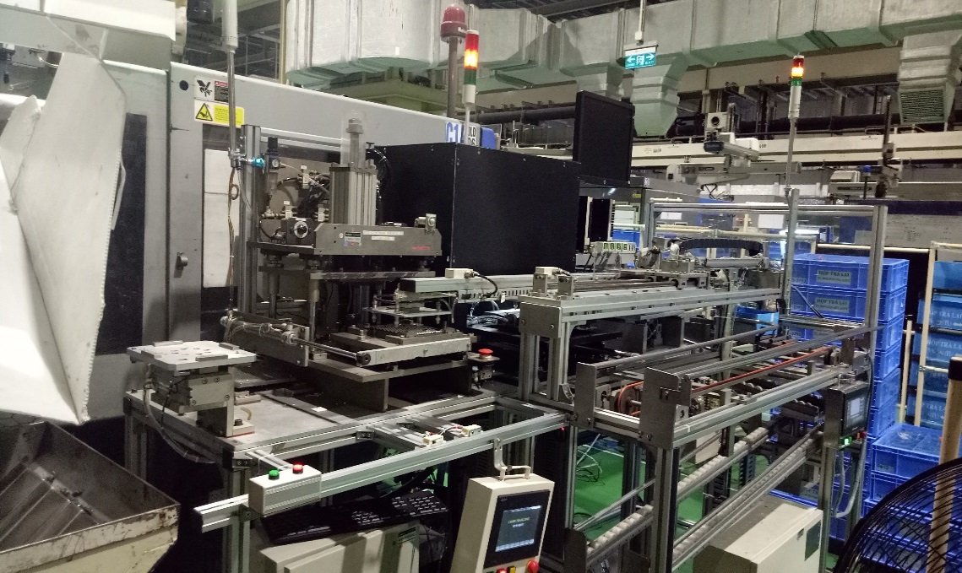
I. OVERVIEW
1.1. Purpose of project
Check direction of rubber
Combine with others unit ➔ Auto system
Target : Auto check after assembly
1.2. Old process and new process.
OLD
NEW
EOS system
Punching unit
Cut gate
Transfer hand
Manual punching (1 OPs)
Manual checking (8 OPs)
Manual boxing
Difficult to control quality.
Easy to make scratch part.
Auto checking
Auto punching & boxing
Easy to control quality.
Not make damage to part.
Katsujin : 9 ops.

Slide 7
PiCamera
PiCamera

Slide 8
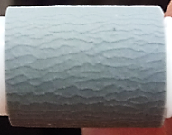
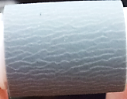
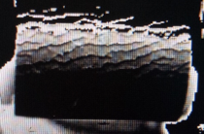
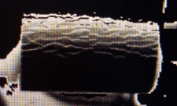
II. INVESTIGATE RESULT
3.1. Result (100pcs)
Sample Item check | Picture
 | NG sample | OK sample
Rubber
Rubber
Check Result | NG | OK

Slide 9
III. NEXT PLAN
3.1. Improve point
3.1.1 Analyzed Image
3.1.2 More Algorithm
3.2. Test with many project
3.2.1 PCB
3.2.2 MOLD
3.2.3 ASSY
Blur

Slide 10
IV. SCHEDULE
Work content | Nov |  |  |  |  |  |  |  |  |  |  |  |  |  |  |  |  |  |  |  |  |  |  |  |  | Dec
 | 6 | 7 | 8 | 9 | 10 | 11 | 12 | 13 | 14 | 15 | 16 | 17 | 18 | 19 | 20 | 21 | 22 | 23 | 24 | 25 | 26 | 27 | 28 | 29 | 30 | 1 | 2 | 3 | 4 | 5 | 6 | 7 | 8 | 9 | 10 | 11 | 12 | 13 | 14 | 15
Camera & Lamp (EOS)
Debug lightingSetup
Summarize NG from 2 picture
Send NG code to PLC
Make spec file
Adjust spec file
Follow run in line
Make report
Reduce overjudge rate
Test & fix spec file
TVP
MP
Apply
Done

Slide 11
Thanks you for your attention
and valuable questions

